Slide 1



PEILab Group Meeting

Slide 2
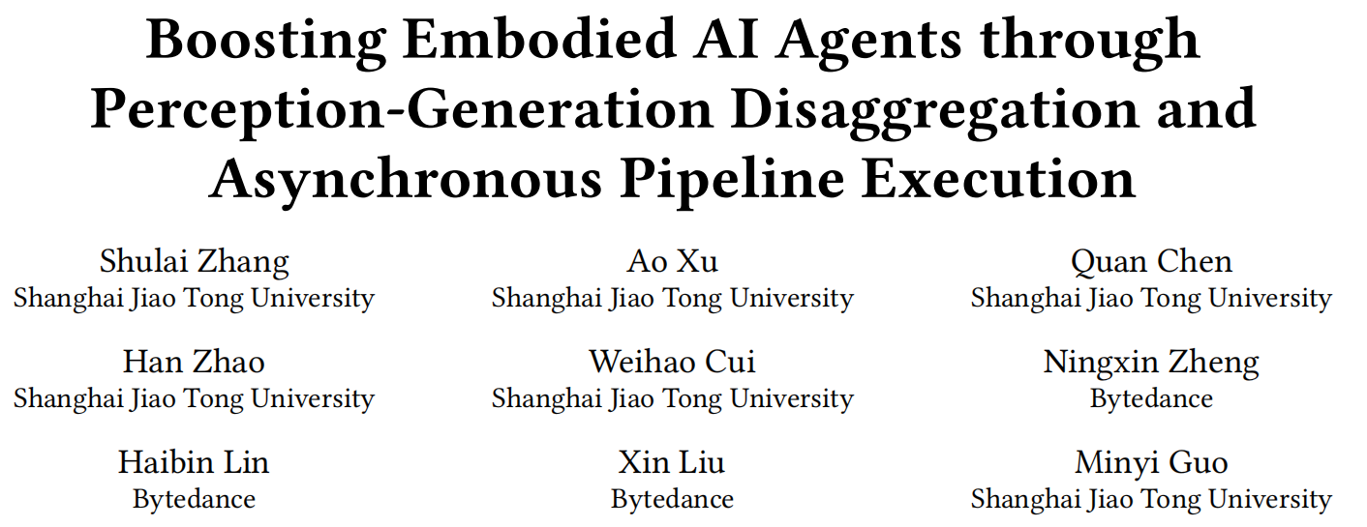
Auras

Slide 3
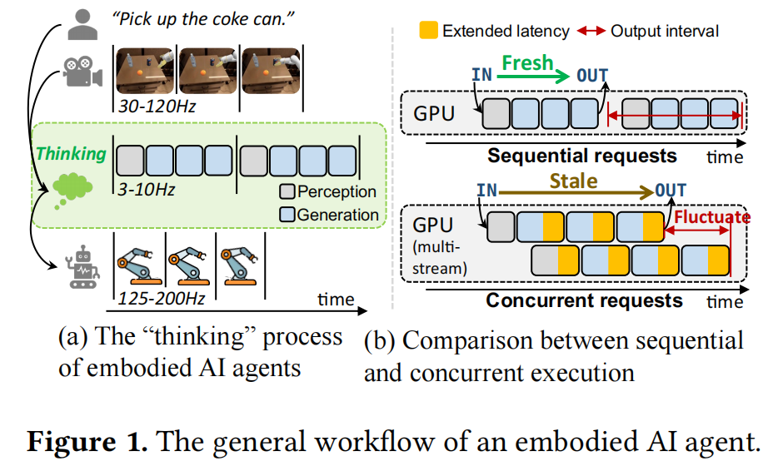
Auras
Motivation
Embodied AI systems operate in dynamic environments, requiring seamless integration of perception and generation modules to process high-frequency input and output demands. Traditional sequential computation patterns, while effective in ensuring accuracy, face significant limitations in achieving the necessary "thinking" frequency for real-world applications
Specifically, each image captured by the camera triggers a
request within the embodied system. This request undergoes
the thinking process to generate an action for the robotics.
Any additional requests generated during this period are
discarded until the current request completes the overall
action generation process

Slide 4
Auras
Challenge
The key obstacle to making good use of current hardwareis that the perception and generation are predominantly implemented in a closed-loop pattern. The sequential compuation of requests hinders possible throughput improvement. There is potential to improve the thinking throughput by increasing the parallelism, but two challenges appear.
First, by parallelizing the original sequential requests, concurrent requests may interfere with each other using techniques such as CUDA multi-stream [1]. This interference hinders the agent from providing stable and high throughput (e.g., the output interval has an 89.8% fluctuation on average).
Second, the latency of each request may be prolonged when paralleled as depicted in Figure 1(b), causing the “thinking” process to compute on staled data, thereby decreasing the agent’s accuracy

Slide 5
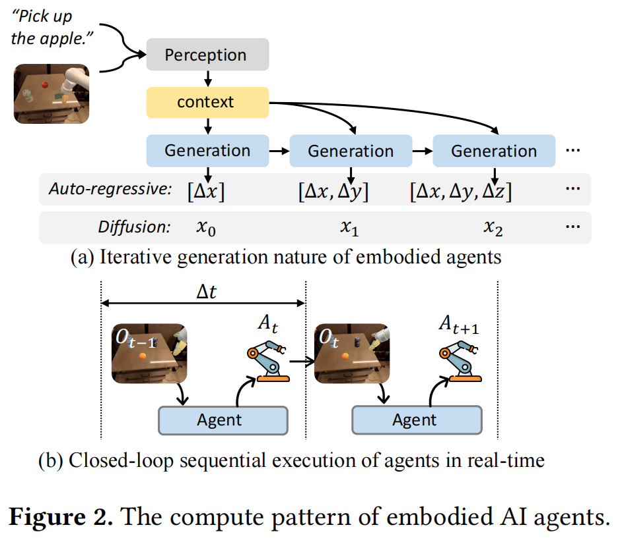
Auras
The perception module receives multiple modal data as input and encodes them into a unified latent space, namely context. In the phase of generating actions or responses, current end-toend embodied agents mainly leverage generative algorithms, because they have the ability to “think” iteratively and perform better in reasoning and planning

Slide 6
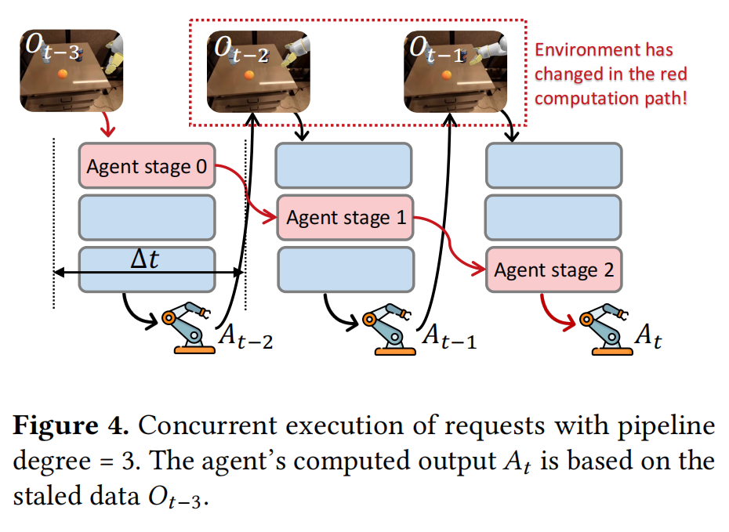
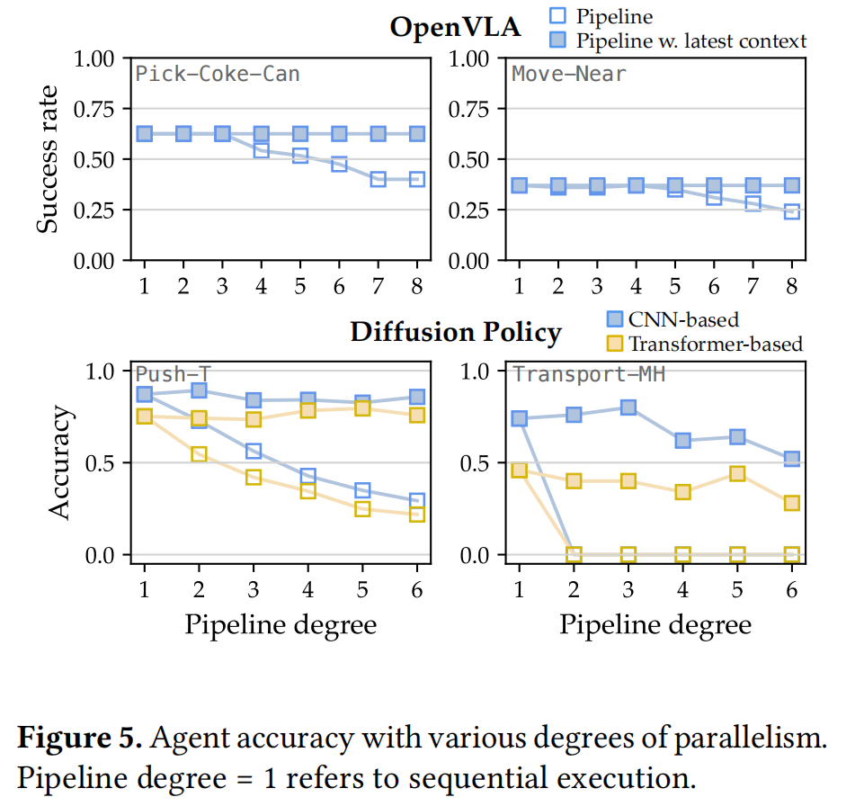
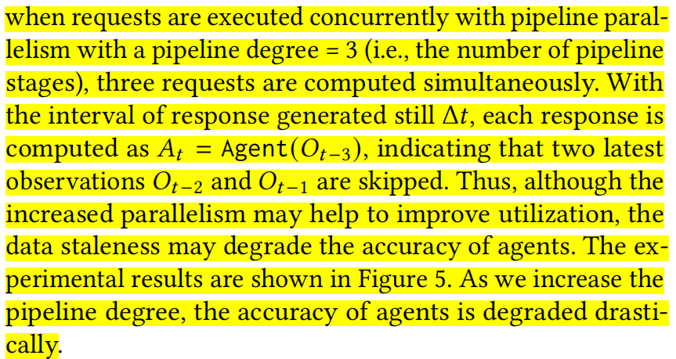
Auras
Challenge 1: Uncontrolled parallelism provides suboptimal throughput.
Structured pipeline parallelism can provide high and stable throughput for embodied AI. It is challenging to manage the parallelism pattern for embodied AI systems because both perception and generation within the system are required to be parallelized for optimal execution. This leads to a complex parallelism configuration space, only by finding out a reasonable configuration within it can help to achieve
both high throughput and agent accuracy.
Challenge 2: Staled data degrades agent accuracy.

Slide 7
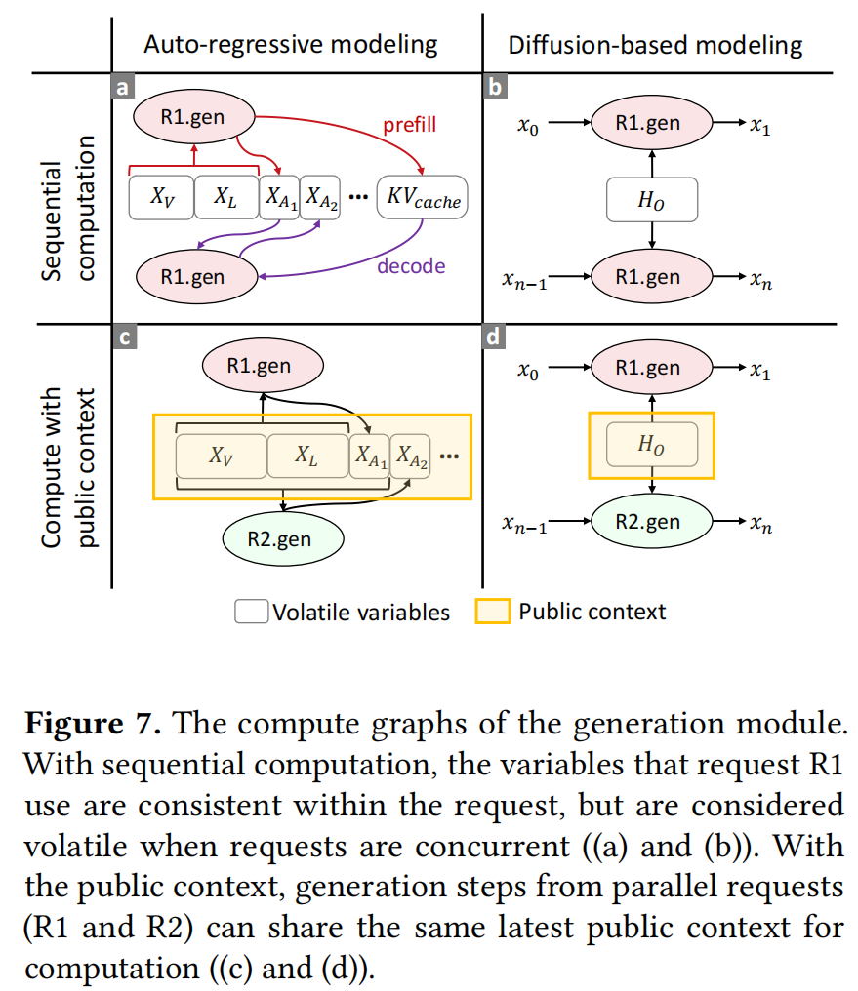
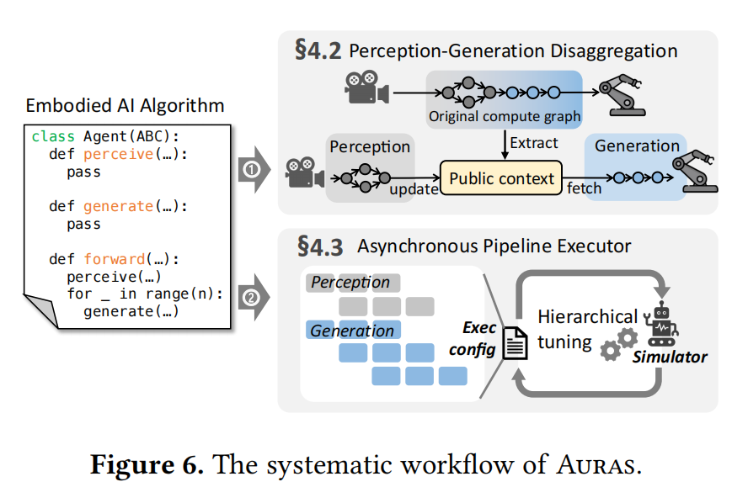
Auras

